Slide 1
Effects of Timbre Encoding Specificity for Musicians and Nonmusicians
Kieth Gryder

Slide 2
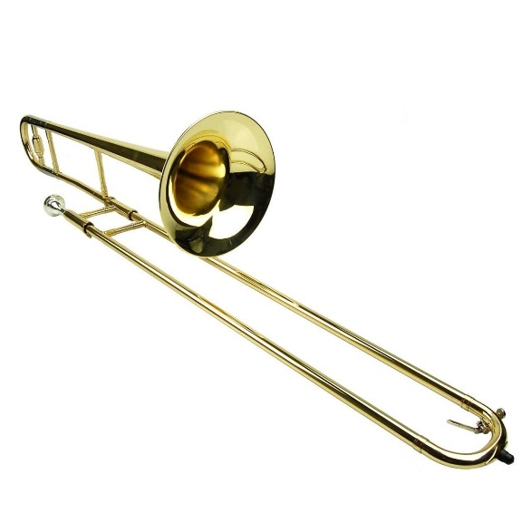
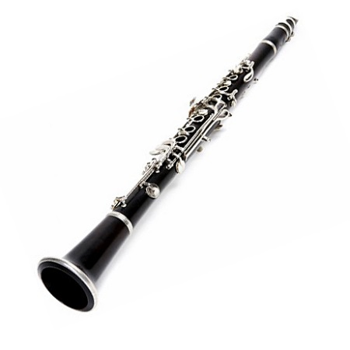
Important Terms
Timbre: the perceived quality of a note or tone in music. Timbre allows us to differentiate two sources of sound that are both producing the same pitch, at the same level of intensity, for the same amount of time, and in the same space.

Slide 3
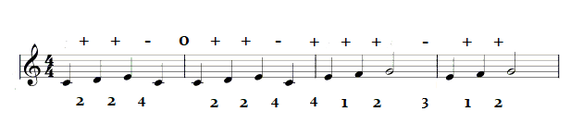
Important Terms
Melody: the relationships among pitches and their timings, essentially giving the melody its identity.
Melodic Contour
Interval Pattern

Slide 4
Literature Review
Encoding specificity: items are better remembered when the context they are learned in matches the context the item was learned in. Tulving & Thomson, 1973; Godden & Baddeley, 1975.
Listeners are sensitive to global timbre of a song and are able to accurately identify popular songs going on only 100ms of exposure. Schellenberg, Iverson, & McKinnon, 1999.
Changing the timbre of a melody leads to lower melody recognition. Radvansky, et al., 1995; Poulin-Charronnat et al., 2004; Trainor, Wu, &Tsang, 2004; Halpern & Müllensiefen, 2008; Lange & Czernochowski, 2013.
Changing the timbre of a melody influences explicit memory, but not implicit memory. Peretz, Gaudreau, & Bonnel, 1998; Halpern & Müllensiefen, 2008.
The effects of timbre change are consistent over long periods of time. Schellenberg & Habashi, 2015.

Slide 5
Literature Review
Lim & Goh, 2012
Experiment 2: Examines the indexical effect of timbre on melody recognition. First paper to include Similar timbre change, as well as Same and Different timbre change.

Slide 6
Literature Review
Lim & Goh, 2012
“Study-then-test” framework.
Study 24 melodies in one specific timbre. Recognition test with 24 new and 24 old melodies in either Same, Similar, or Different timbre:
Experience: 0 – 5 years = Nonmusician; 5+ years = Musician .

Slide 7
Literature Review
Lim & Goh, 2012
Results:
Same and Similar timbre changes were not significantly different from each other, but both were significantly higher than Different timbre change.
Musicians had higher overall performance than Nonmusicians, but the effects of timbre change were similar for both groups.

Slide 8
Research Questions
Will the findings of Lim & Goh (2012) replicate under more structured and realistic methods?
Is there a difference between musicians with a lot of experience, musicians with a few years of experience, and those with little to no experience in melody recognition with timbre change?
What are the effects of timbre change on recognition that requires more sensitivity to pitch-interval pattern information, rather than overall contour information?

Slide 9
Current Experiment Changes
1) Transpose all test melodies. (Dowling, Kwak, & Andrews, 1995)
2) Continuous running memory task. (Dowling, Kwak, & Andrews, 1995; Shepard & Teghtsoonian, 1961)
3) More distinct levels of expertise. (Dowling, 1986)
-Highly trained musician: 10+ years of music training.
-Moderate musician: 2 – 9 years of music training.
-Nonmusician: Less than 2 years of music training.
4) Explore timbre change effects on similar contour lures. (Dowling, Kwak, & Andrews, 1995)

Slide 10
Design (Continued)
Test Items: Short, single phrase, monophonic melodies.
Melodies from traditional folk songs, made in MuseScore 2.0.
Stimuli recorded via Cakewalk and Audacity.
-6 lists to balancing melodies across timbres and test items.
-36 New “Different Contour” Melodies:
A new, to-be-remembered melody
-18 Target Melodies:
Melody is the same as a previous test item, only transposed to a nearby key.
-18 “Similar Contour” Lures:
Melody is similar to a previous test item, but two of the notes in the second half of the melody were changed by one or two diatonic steps. Transposed as well.

Slide 11
Design (Continued)
Participants given experiment instructions & examples. (Wolport, 1990; Radvansky et al., 1995)
Participants rated 72 melodies on a 4 point scale based on whether they believed they had heard the melody previously in the study, regardless of the instrument playing the melody, via Matlab.
[Yes] [No]
4 = Sure Same 2 = Different
3 = Same 1 = Sure Different
Each new melody is played in one of 6 different timbres:
Piano & Harpsichord
Violin & Cello
Clarinet & Tenor Saxophone
The related test melody was presented 2 – 4 trials later and either stayed in the same timbre, shifted to a similar timbre, or shifted to a different timbre.

Slide 12


Example
Trial 1
DC
DC
Trial 2
Target (T-1)
Trial 3
Trial 4
SC Lure (T-2)
Same
Trial 5
Same
DC
Similar
SC Lure (T-3)
Trial 6
Different
Trial 7
Different

Slide 13
Demographics
N = 182, recruited from UTDallas or communities around the DFW area.
60 Nonmusicians
(Exp = .5 year, Age = 22 years )
60 Moderate Musicians
(Exp = 5 years, Age = 22 years)
62 Highly Trained Musicians
(Exp = 16.5 years, Age = 29 years)

Slide 14
Design
3 x 3 x 2 Mixed ANOVA
One between subjects factor:
-Expertise (nonmusician, moderate, highly trained)
Two repeated measures:
-Timbre (same, similar, different)
-Item Type (T/SC and T/DC)
Measurements:
-Hits
-False Alarms for Similar Contour Items
-False Alarms for Different Contour Items
*Area under the ROC (Swets, 1973)

Slide 15
Results: Overall

Slide 16
Results
Experience Main Effect
F(2, 179) = 18.97, MSE = .061, p < .001, η_{p}² = .175, 95% CI [ .080, .267]
Highly Trained had higher performance than Moderate and Nonmusicians, but Moderate and Nonmusicians were not significantly different from each other.
Bonferroni:
UMD = .103, p = <.001, 95% CI [ .059, .147] High - Non
UMD = .090, p = <.001, 95% CI [ .046, .134] High - Mod
Timbre Main Effect
F(2, 358) = 7.99, MSE = .028, p < .001, η_{p}² = .043, 95% CI [ .009, .087]
Changing to a Different timbre resulted in lower performance than Same and Similar timbre conditions, but Same and Similar were not significantly different from each other.
Bonferroni:
UMD = -.037, p = .012, 95% CI [ -.067, -.006] Different - Same
UMD = -.047, p = <.001, 95% CI [ -.077, -.018] Different - Similar
Item Type Main Effect
F(1, 179) = 227.53, MSE = .008, p < .001, η_{p}² = .560, 95% CI [ .465, .629]
T/DC overall higher than T/SC
Bonferroni:
UMD = .082, p = <.001, 95% CI [ .071, .093] DC - SC

Slide 17
Results
Item Type X Timbre Interaction
F(2, 358) = 8.78, MSE = .009, p < .001, η_{p}² = .047, 95% CI [ .011, .091]
Simple Main Effect for T/DC
F(2, 178) = 16.47, p = <.001, η_{p}² = .156, 95% CI [ .065, .246]
Different timbre was significantly lower in T/DC than Same and Similar
Bonferroni:
UMD = -.066, p = <.001, 95% CI [ -.097, -.035] Diff vs Same
UMD = -.060, p = <.001, 95% CI [ -.091, -.029] Diff vs Sim
----------------------------------------------------------------------------------------------------------------------
Simple Main Effect for T/SC, marginally significant.
F(2, 178) = 3.01, p = .052, η_{p}² = .033, 95% CI [ .000 , .091 ]

Slide 18
Results: T/DC

Slide 19
Results: T/SC

Slide 20
Results
Item Type X Timbre Interaction
F(2, 358) = 8.78, MSE = .009, p < .001, η_{p}² = .047, 95% CI [ .011, .091]
Simple Main Effect for T/SC, marginally significant.
F(2, 178) = 3.01, p = .052, η_{p}² = .033, 95% CI [ .000 , .091 ]
----------------------------------------------------------------------------------------------
A closer look just between Moderate and Nonmusicians.
N = 120
Simple Main Effect for T/SC
F(2, 117) = 5.28, p = .006, η_{p}² = .083, 95% CI [ .007, .180]
Different timbre was significantly lower for T/SC than Similar, but not Same timbre
Bonferroni:
UMD = -.060, p = .005, 95% CI [ -.106, -.015] Diff vs Sim
(not significant)
UMD = -.041, p = .120, 95% CI [ -.088, .007] Same vs Sim

Slide 21
Results: T/SC

Slide 22
Results: Hits & False Alarms

Slide 23
Results: Hits & False Alarms

Slide 24
Results: Hits & False Alarms

Slide 25
Discussion
Highly Trained Musicians were distinctly better at the task than moderate musicians, who performed similarly to nonmusicians for both T/DC and T/SC measures.
T/DC results replicate Lim & Goh (2012) findings.
For melody recognition, changing to a similar timbre seems as effective as staying in the same timbre, but switching to a distinctly different timbre leads to a weaker memory trace and lower recognition.

Slide 26
Discussion
T/SC results show that highly trained musicians are not significantly influenced by timbre change when discriminating similar contour lures from targets.
Better internal representation of the melody.
Better ability to attend to specific intervals, resist influences from timbre.
Moderate and Nonmusicians seem to have better performance when the melody is presented in a similar timbre than when it stays in the same timbre. However, their performance drops when there is a change to a distinctly different timbre.

Slide 27
Discussion
Moderate and Nonmusicians seem to have better performance when the melody is presented in a similar timbre than when it stays in the same timbre. However, their performance drops when there is a change to a distinctly different timbre.
Increase in familiarity from similar timbre and similar contour, but the similar timbre might interact with the change in pitch intervals and be more salient to these participants. (Pitt, 1994; Warrier & Zatorre, 2002)
Alternatively, their attention might be heightened by the similar timbre, but still receive the memory trace aid from encoding specificity and similar contour.
Distinctly different timbre change does not aid in the memory trace.

Slide 28
Discussion
SC discrimination is an automatic or implicit procedural task. (Bartlett, Halpern, & Dowling, 1993; Dowling, Kwak, & Andrews, 1995)
Participants felt they were guessing on T/SC discrimination, although on average they performed well above change.
T/SC discrimination, as an implicit procedural task does not draw on working-memory capacity, and is more affected by expertise.
(Bartlett, Halpern, & Dowling, 1993)

Slide 29
Limitations
Low variability among melodies. Melodies were short, all in major keys, same tempo, and all ended on the tonic. There was only variation in keys, melodic contour, timbre, and time signature (4/4, 3/4, 6/8).
Use of MIDI and artificial timbres, instead of live excerpts.
Possible differences between musicians with a lot of experience verses actual professionals.
Lack of balance across delay conditions.

Slide 30
Future Directions
Look at the long term effects of similar timbre change on melody recognition.
Continue research on surface feature change effects on T/SC discrimination tasks.
Look at the effects of similar timbre change in other implicit procedural tasks.
Distributed vs massed learning and surface feature changes. (Lange & Czernochowski, 2013)

Slide 31
Questions?

